Slide 1


FIGMA-BASED UI DESIGN FOR MARINE TRAVEL APPS
(UI/UX PROJECT)
Presented By:
Haemjeyent A – 811721104030
Guided by
V.Kalpana, M.E,(Ph.D.)

Slide 2
CONTENTS
Objectives
Problem Statement
Existing System
Proposed System
Workflow
Architecture
Modules
Conclusion

Slide 3
OBJECTIVES
To design an intuitive and user-friendly interface for marine travel applications using Figma.
To enhance the user experience for travelers by providing clear navigation, booking, and real-time tracking features.
To create wireframes, prototypes, and UI components tailored to the needs of marine travel (e.g., ferry booking, cruise details, port information).
To ensure accessibility, responsiveness, and visual appeal across various devices.
To streamline the design handoff process between designers and developers using Figma’s collaboration tools.

Slide 4
PROBLEM STATEMENT
Existing marine travel apps often have outdated or poorly designed user interfaces.
Users struggle with navigation, booking tickets, and accessing key travel information.
Inconsistent design across platforms leads to confusion and a poor user experience.
Real-time features like route tracking, delays, and port updates are often not clearly presented.
Lack of accessibility options makes apps difficult to use for people with disabilities.
Current design processes lack efficient collaboration between designers and developers.

Slide 5
EXISTING SYSTEM
Most marine travel apps have cluttered and confusing user interfaces
Users face difficulties in booking or managing travel efficiently.
Navigation is not intuitive, making it hard to find key features.
UI lacks clear iconography and consistent design elements.
Designs often ignore user-centric principles, reducing usability.
Accessibility features are minimal or nonexistent, affecting user inclusivity.
Inconsistent experience across different platforms and devices.

Slide 6
PROPOSED SYSTEM
A user-friendly mobile app interface specifically designed for marine travel booking.
Developed using Figma to create interactive, high-fidelity UI prototypes.
Features intuitive navigation for easy access to booking, schedules, and travel information.
Ensures design consistency with modern visual elements and layout standards.
Supports responsive design, making the app accessible across various devices.
Focuses on a user-centered approach to enhance usability and streamline the travel experience.

Slide 7
WORK FLOW – 15 DAYS
Low-Fidelity design – 3 days
High-Fidelity UI design – 5 days
Prototyping – 3 days
Testing & Handoff – 4 days

Slide 8
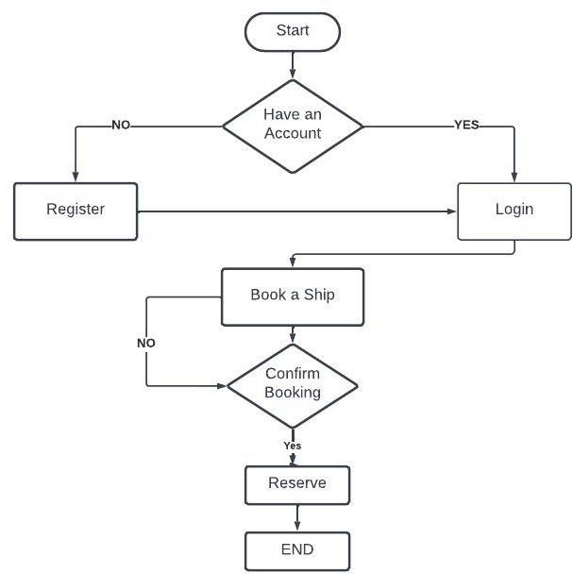
ARCHITECTURE

Slide 9
MODULES
User Onboarding & Authentication
Home Dashboard
Search & Explore Routes
Schedule & Availability
Booking Module
Trip Management
Notifications & Alerts
User Profile & Preferences
Support & Help Center

Slide 10
MODULES - Search & Booking Module
Allows users to search for available marine routes (ferries, cruises, yachts).
Includes filtering by destination, time, date, vessel type.
Handles booking flow: select route → choose seat/cabin → enter details → payment.

Slide 11
MODULES - Trip Management Module
Displays upcoming, ongoing, and past trips.
Includes digital tickets/boarding passes, vessel info, departure time.
Provides options to cancel, reschedule, or track real-time trip status.

Slide 12
MODULES - User Profile & Preferences Module
Stores user information and travel history.
Allows updates to personal details, saved preferences, and payment methods.
Manages notifications, language settings, and support access.

Slide 13
OUTPUT

Slide 14
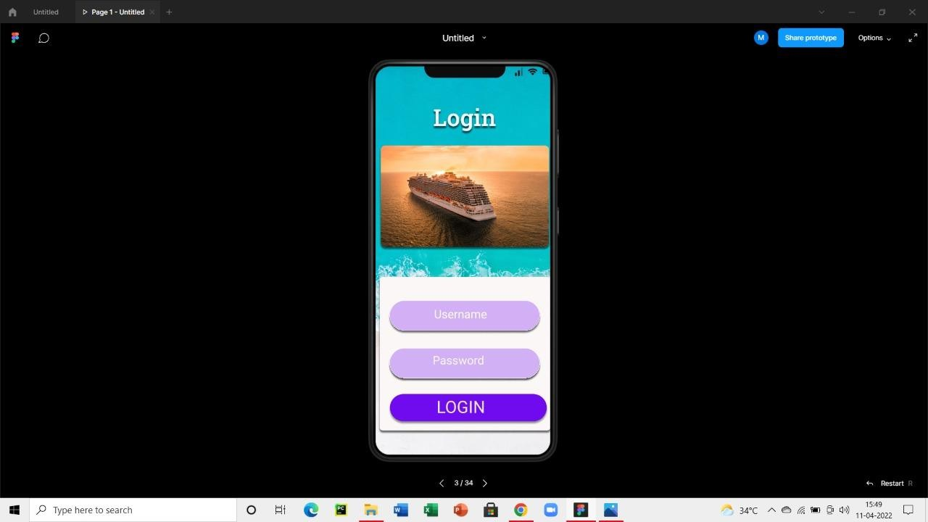
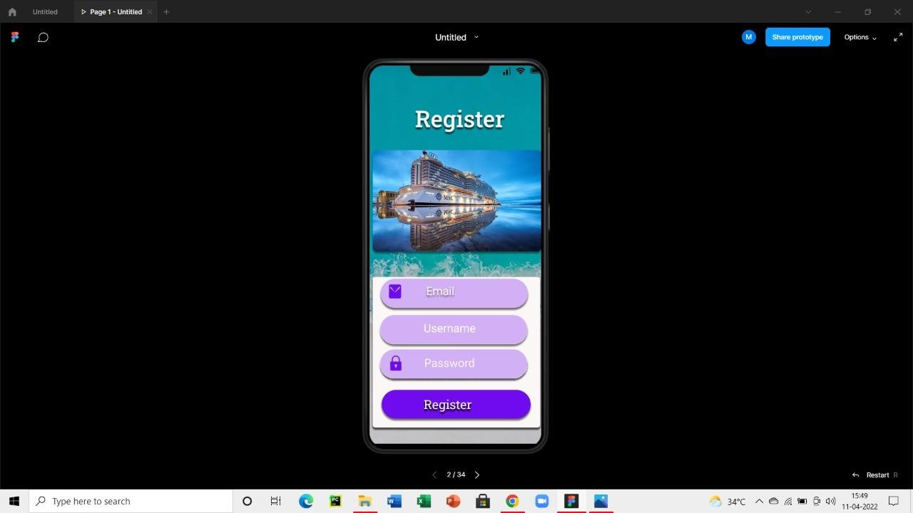

Slide 15
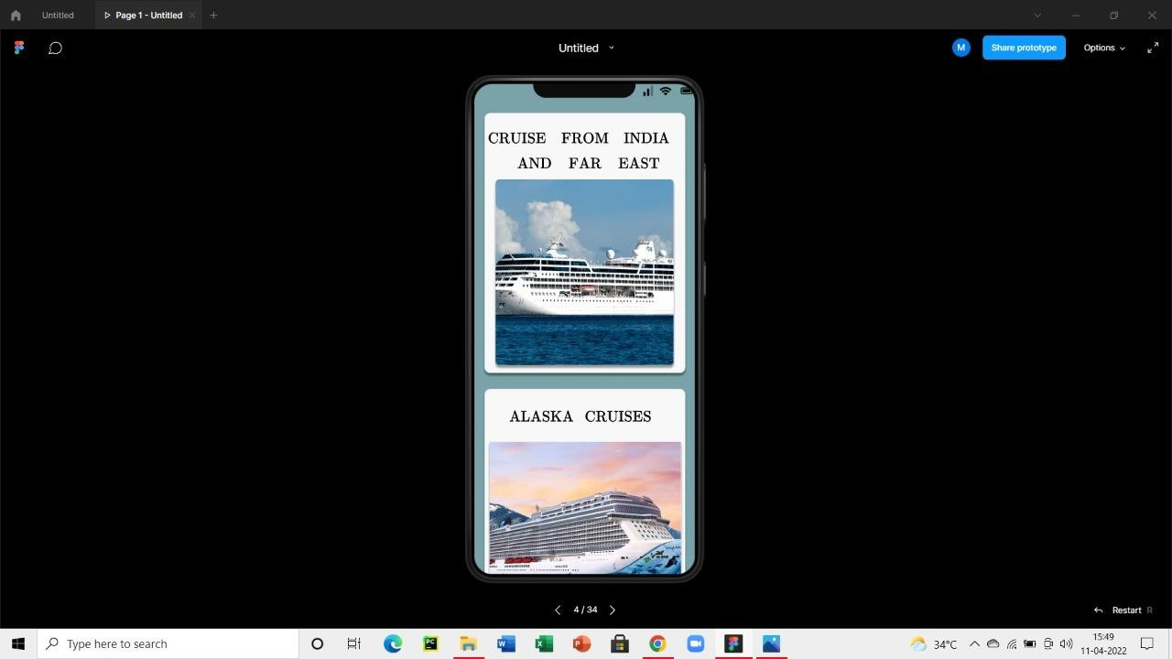
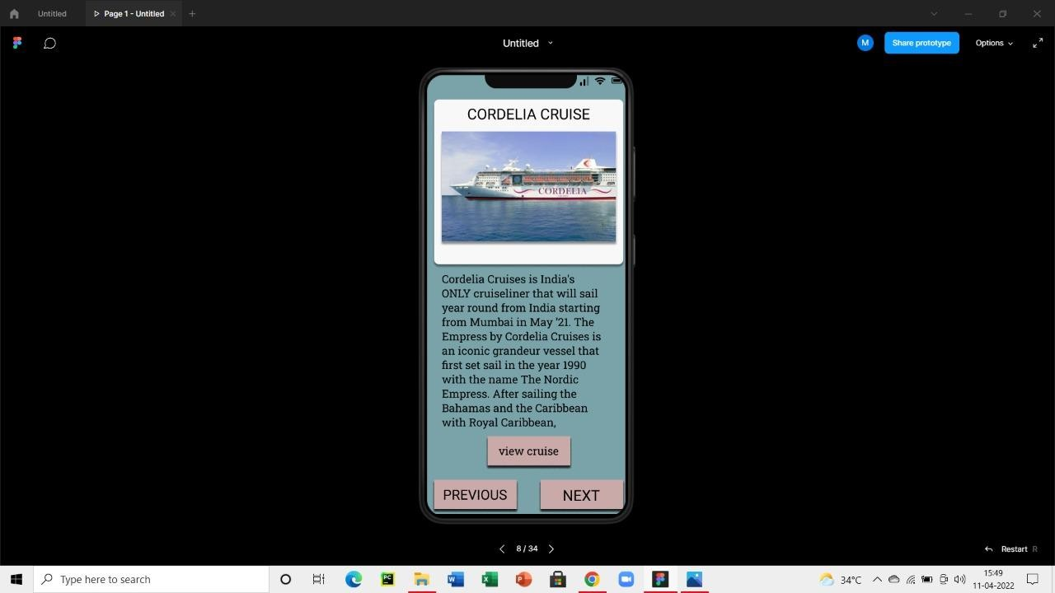

Slide 16
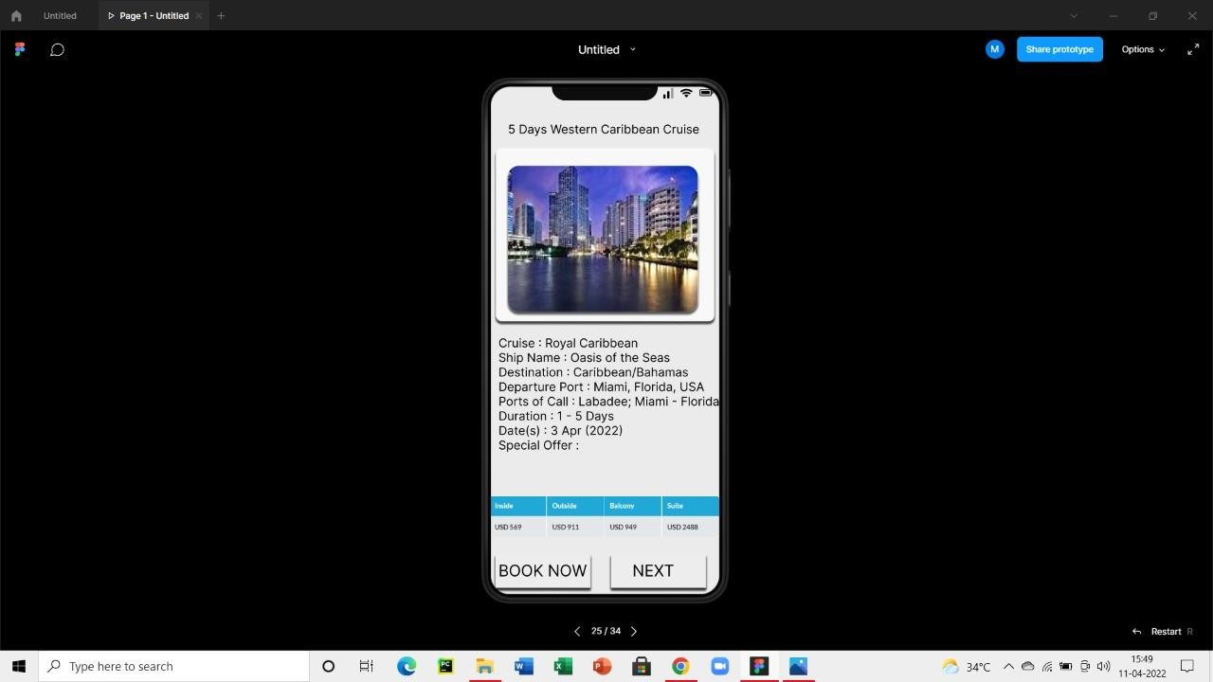

Slide 17
CONCLUSION
The Figma-based UI design for the marine travel app provides a clean, user-friendly interface that ensures easy navigation, efficient ticket booking, and clear information display. By maintaining consistent typography, spacing, and color schemes, the app enhances usability and visual appeal. Key features like login, ship search, booking, calendar selection, passenger details, and secure payment are well-integrated into the prototype, offering a smooth and intuitive user experience. This design helps save time, improves efficiency, and supports both domestic and international marine travel.

Slide 18
THANK YOU

